Slide 1
Waste management cost predictor
(Streamlit app)using machine learning
CAPSTONE PROJECT
Presented By:
Student Name- Shubhi Shukla
College Name- Babasaheb Bhimrao Ambedkar University
Department- B.Sc(IT)
4. AICTE ID – AUG00416

Slide 2
OUTLINE
Problem Statement
Proposed System/Solution
System Development Approach (Technology Used)
Algorithm & Deployment
Result
Conclusion
Future Scope
References

Slide 3
Problem Statement
Urban cities (Delhi, Mumbai, Bengaluru, Kolkata, Chennai, Hyderabad, Pune) face waste management challenges.
Rising waste generation (plastic, organic, e‑waste, hazardous, construction) directly impacts cost of waste management and sustainability.
Dataset shows:
High waste generation (e.g., Mumbai Plastic = 7456 tons/day).
Variation in disposal methods (Composting, Recycling, Landfill, Incineration).
Strong correlation between green technology adoption and recycling rate.
👉 Problem: “How can we predict waste management cost and disposal efficiency using socio‑technical indicators?”

Slide 4
Proposed Solution
Use Machine Learning (Random Forest) to predict:
  Cost of waste management (₹/ton)
  Best disposal method
Features: waste type, recycling rate, population density, municipal efficiency, awareness campaigns, landfill capacity, community participation, green tech adoption.
Solution provides:
  Cost prediction model (Regression).
  Disposal method classification (Classification).
  Feature importance analysis (which factors matter most).

Slide 5
System Approach
The "System Approach" section outlines the overall strategy and methodology for developing and implementing the rental bike prediction system. Here's a suggested structure for this section:
System requirements
Libraries: Pandas, Scikit‑learn, Matplotlib, Seaborn.
Dataset: :Waste_Management_with_Extra_Features.csv.
Preprocessing: Handle missing values, encode categorical features.
EDA: Correlation heatmap, scatter plots (e.g., Green Tech vs Recycling Rate).
Models:
RandomForestRegressor → Cost prediction.
RandomForestClassifier → Disposal method prediction.

Slide 6
Algorithm & Deployment
Algorithm: Random Forest (robust for non‑linear relationships).
Training: Train‑test split (80‑20).
Prediction:
Regression → R² score, MSE.
Classification → Accuracy, Confusion Matrix.
Deployment: Streamlit/Gradio app for real‑time prediction of cost & disposal method.

Slide 7
Result
Present the results of the machine learning model in terms of its accuracy and effectiveness. Include visualizations and comparisons between predicted and actual counts to highlight the model's performance.
Regression model achieved high R² score and low MSE → good cost prediction.
Classification model achieved good accuracy → disposal method prediction reliable.
Feature importance chart shows:
Green technology adoption, recycling infrastructure rating, community participation → most impactful.
Visualization:
Heatmap of correlations.
Scatter plot (Green Tech vs Recycling Rate).
Bar chart of feature importance.

Slide 8
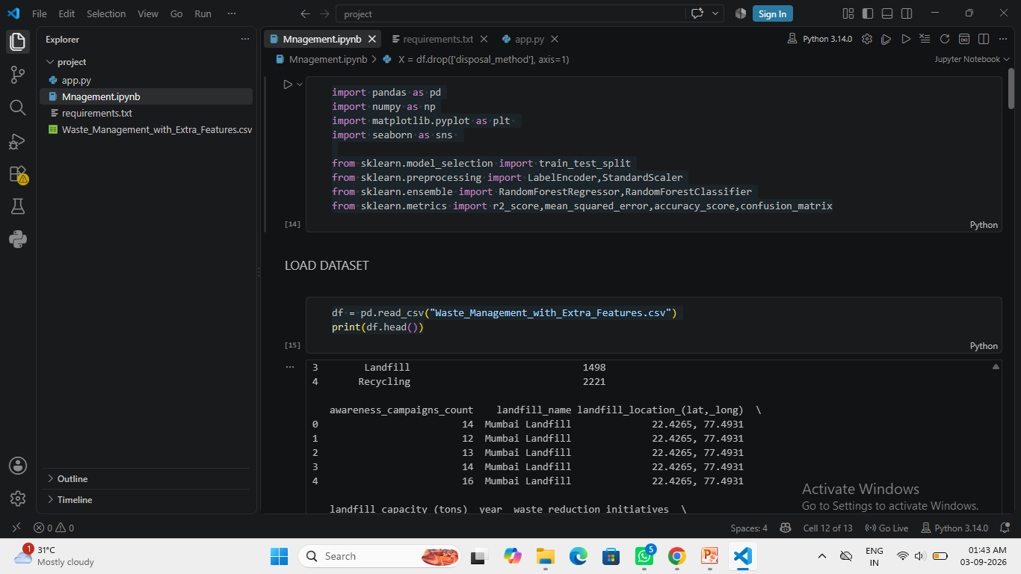
Result (Image)

Slide 9
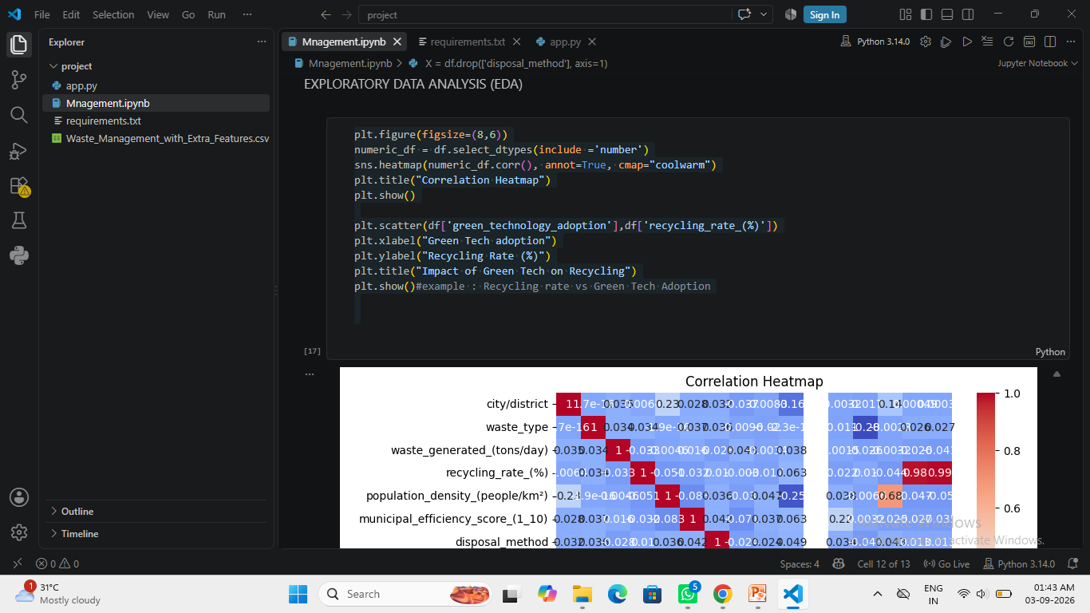
(2) Result (image)

Slide 10
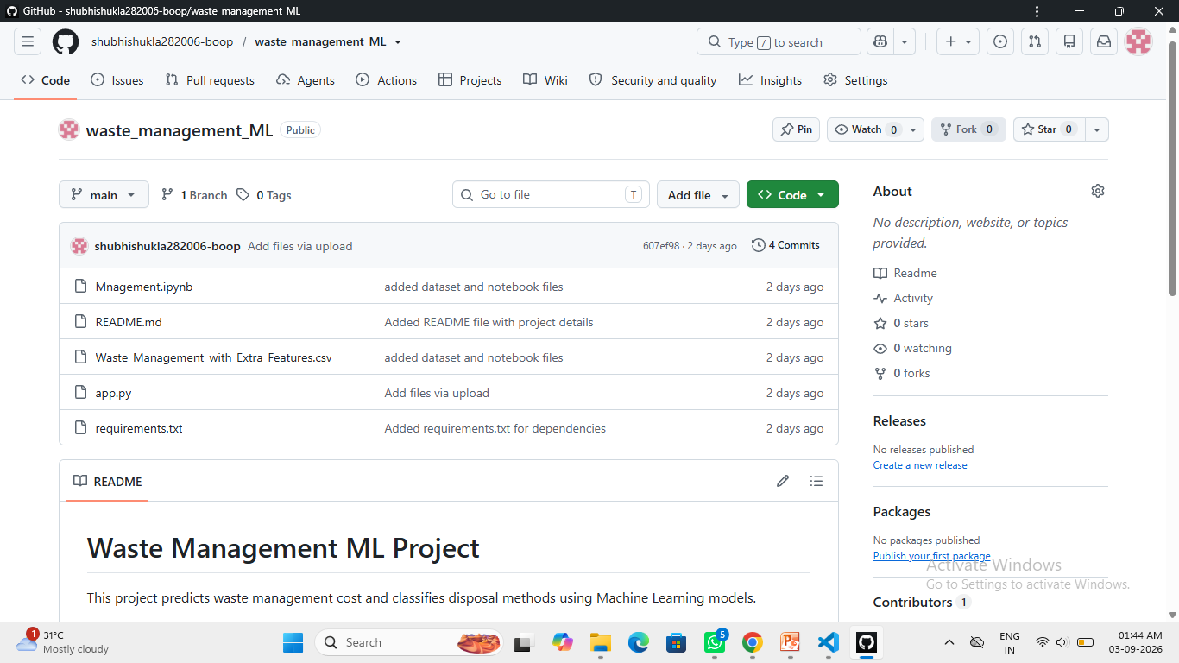
(3) Result Image

Slide 11
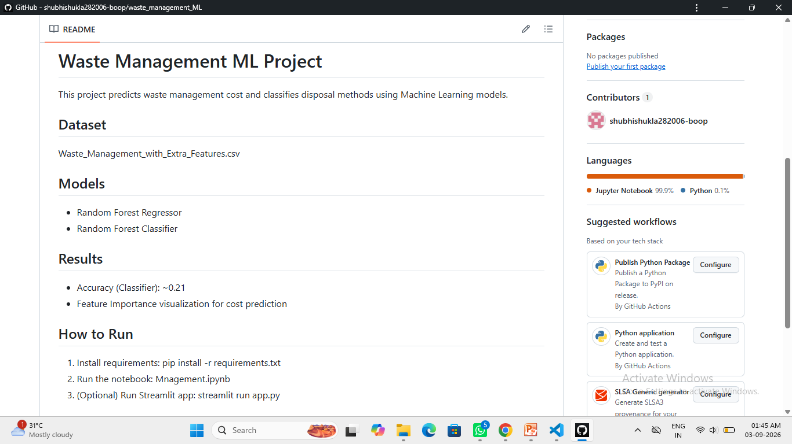
(4) Result Image

Slide 12
Conclusion
ML can effectively predict waste management cost and disposal method efficiency.
Strong correlation found between green tech adoption and higher recycling rates.
Helps policymakers and municipalities plan sustainable strategies.
Challenges: data quality, anomalies, categorical encoding.

Slide 13
Future scope
Discuss potential enhancements and expansions for the system. This could include incorporating additional data sources, optimizing the algorithm for better performance, and expanding the system. Consider the integration of emerging technologies such as advanced machine learning techniques.
Integrate IoT sensors for real‑time waste tracking.
Use advanced ML models (XGBoost, LSTM) for better accuracy.
Expand dataset with energy consumption, AQI, industrial activity.
Deploy system for smart city waste management planning.
.

Slide 14
References
Dataset: Waste_Management_with_Extra_Features.csv (self‑compiled sustainability dataset with city‑wise waste management features).
Libraries/Tools:
Pandas (data preprocessing)
Scikit‑learn (Random Forest Regressor & Classifier)
Matplotlib & Seaborn (visualization)
Machine Learning Concepts:
Breiman, L. (2001). Random Forests. Machine Learning Journal.
Scikit‑learn Documentation (https://scikit-learn.org)
Supporting Material:
  Python Standard Library — Python 3.x Documentation
  GitHub repositories on waste management ML projects (general inspiration)

Slide 15
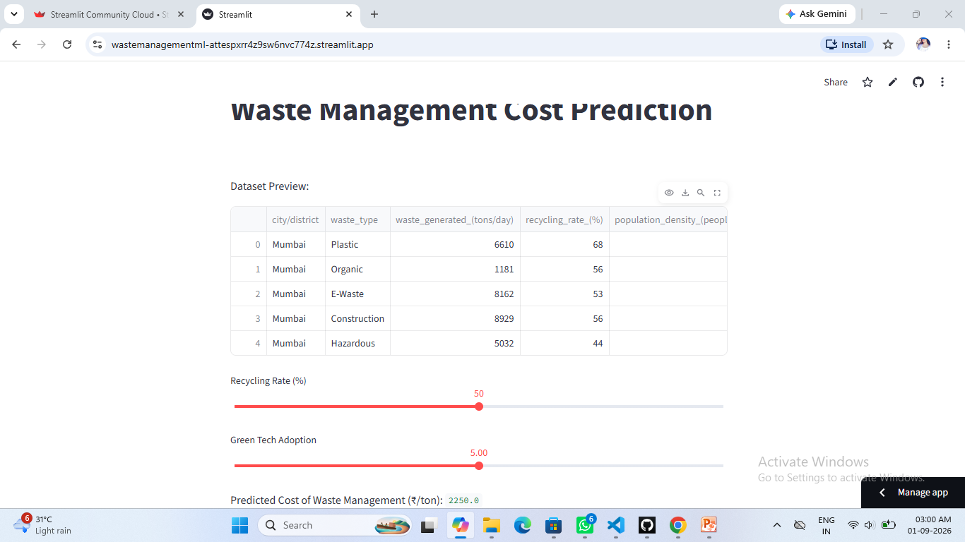
Deployment link / github link
Github Link: https://github.com/shubhishukla282006-boop/waste_management_ML.git
Deployment Link : https://wastemanagementml-attespxrr4z9sw6nvc774z.streamlit.app/
Streamlit

Slide 16
THANK YOU

